Slide 1
Analyzing Toronto’s Neighborhood
Visualizing for potential newcomers
Group 36
Abdul Bhutta 100785884
Shreya Sharma 100725334
Disha Panday 100725039

Slide 2
Introduction
We took the city of Toronto and segmented it into separate neighborhoods based on their geological coordinates. The neighborhoods will then be grouped into clusters using a combination of location data from the Foursquare API and artificial intelligence (clustering).

Slide 3
Problem Statement
The goal of this project is to better comprehend and visualize Toronto's neighborhood for new-comers. We wanted to visualize each segment of the city to determine which neighborhood we should reside in since we would be graduating next year and going to Toronto for employment.

Slide 4
Data Sources Used and Explained
Toronto’s neighborhoods classified by postal code
Geospatial Coordinates of each neighborhood with postal code
Shape data to obtain the Latitude, Longitude locations and the geometry of the city
Each neighborhood's venue (Police Station) type
Income and Crime Rate Statistics Corresponding to the city of Toronto

Slide 5
Methodology
Foursquare API: We signed up for a foursquare API developer account and learned how to access the API with Python. Longitude, Latitude and venues are all found using Foursquare
Preparing data: This stage was all about gathering information from all of the previously stated sources. We figured out what our project's key contribution was and what we intended to accomplish. We also combined all of the obtained datasets into one to begin clustering

Slide 6
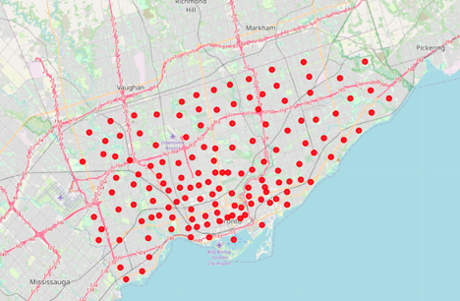
Key Dimensions for consideration :
Total Income of households
Crime rates in neighbourhood
Police stations per neighbourhood coordinate
Neighborhood segmentation and clustering(K-means Clustering): We learned clustering using Python for segmenting and clustering the neighborhoods in this stage. The cluster criteria has to be in line with our project objectives. We next chose the crime rate as well as the source of income that was taxed, and we explored the relationship between the two
All the Neighborhoods visualized on the maps

Slide 7
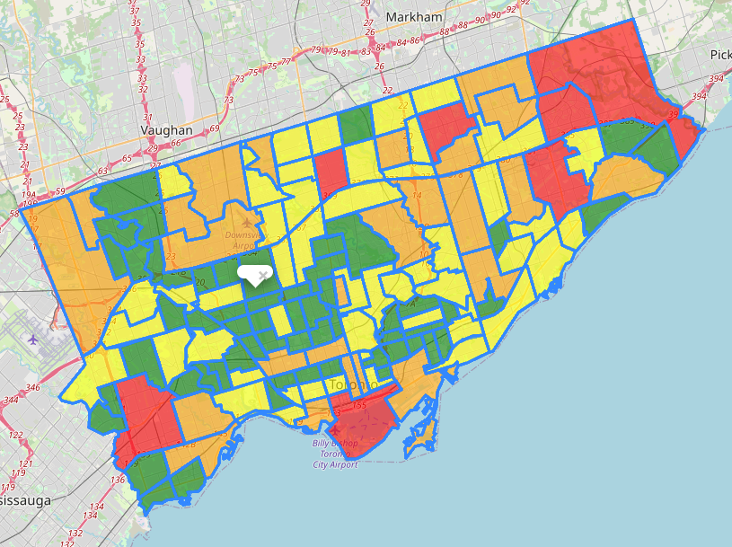
Result and Observation
After clustering, the data was divided into four clusters. The geometry coordinates for each neighborhood can be used to visualize these four clusters on the map. To represent the ideal location, each cluster is assigned a color. According to the data, the green area is the best place to live in Toronto because it has the lowest crime rate and population while also having the most police stations.

Slide 8
Conclusion
We looking to build this study and project to include household size and age, as well as to other major Canadian cities (e.g., Vancouver, Montreal). Although the maps are not a perfect instrument for potential newcomers to make key decisions, they do provide a high-level overview of Toronto's character and distributions, which should aid in the research process by providing those who are unfamiliar with the city with a better understanding of it.

